Slide 1
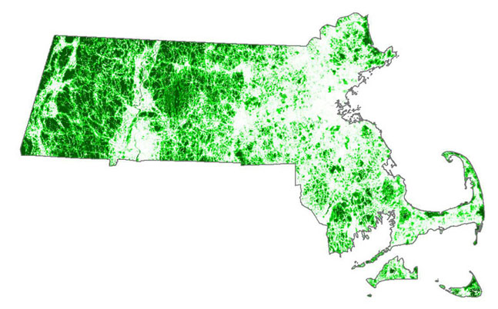

CAPS Scenario Builder
Version 1.0, April 2013

